Slide 1

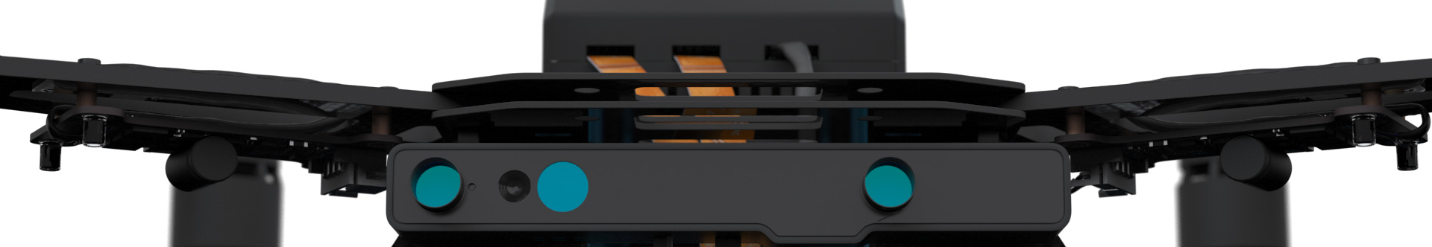
Autonomous Drone Engineer A2 – Usage Models
Paul.Guermonprez@intel.com Autonomous Drone Solutions Architect

Slide 2
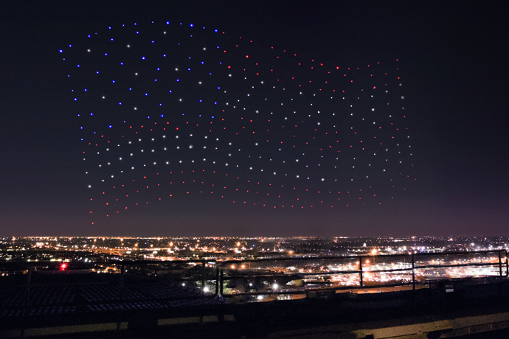
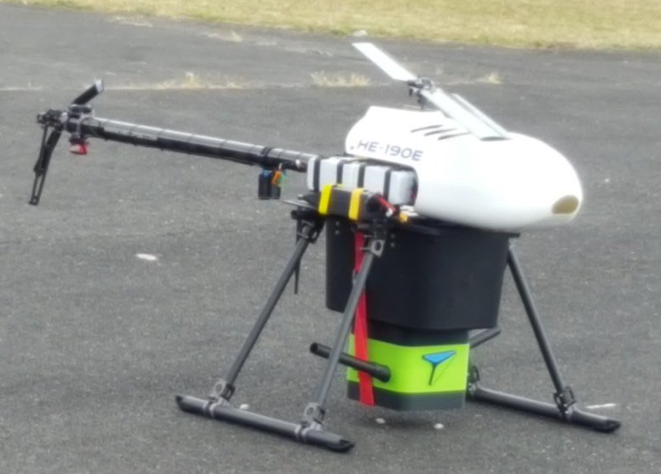
Why autonomous? Fleets!
Autonomous drones are required when you need a very large fleet.
There’s not enough pilots for the fleet
Pilots can’t synchronize their flight
Ex: last 10 miles logistics, precision agriculture, light shows
Photos: Intel’s Drone Light Show for the 2017 Super Bowl Pest prevention for agriculture
https://newsroom.intel.com/news-releases/intel-drones-light-lady-gaga-performance-pepsi-zero-sugar-super-bowl-li-halftime/ https://agribird.com/produits/trichogrammes-trichospray/

Slide 3
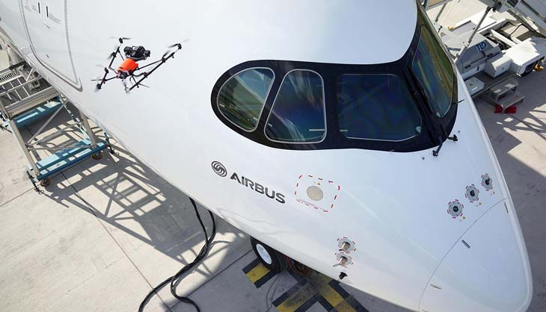
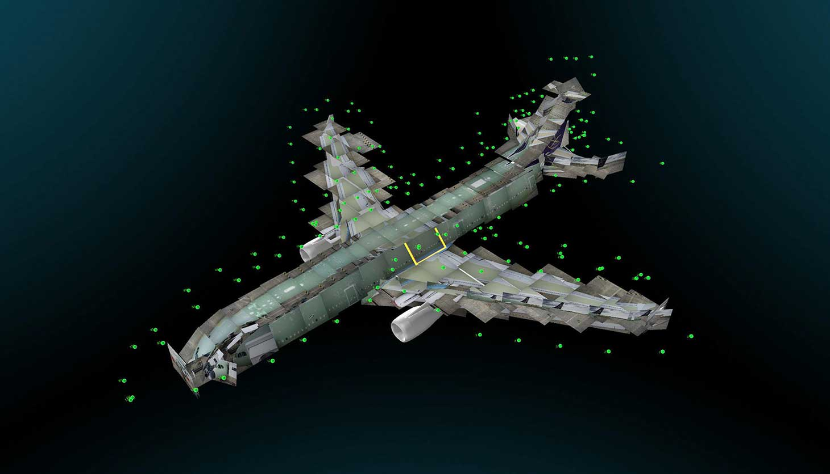
Why autonomous? Precision!
Autonomous drones are required when you need to fly precisely.
Photos need to be taken from a precise point
Successive flights need to follow the same path
Or when you need predictability.
Flying on dangerous sites
Or near highly valuable objects
Ex: precise infrastructure inspection, movie shooting (James Bond Skyfall* intro chase).
Photos: Intel-Airbus* collaboration.
*Other names and brands may be claimed as the property of others
http://www.asctec.de/en/intel-airbus-demo-drone-visual-inspection-of-passenger-airliners/

Slide 4
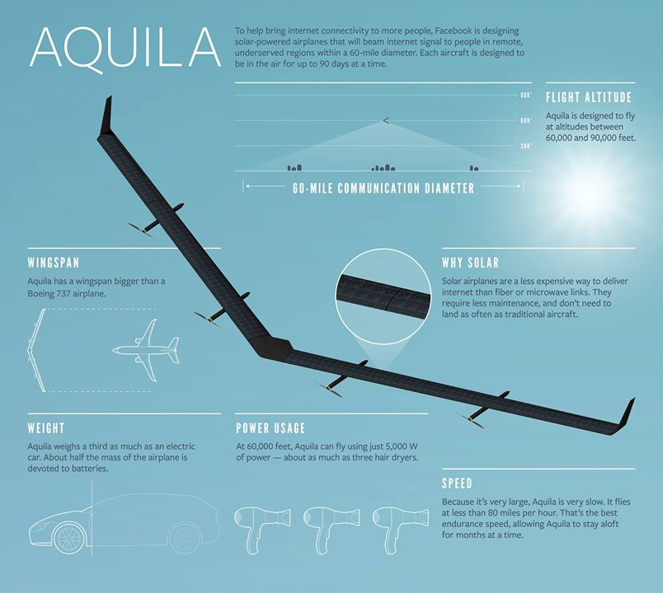
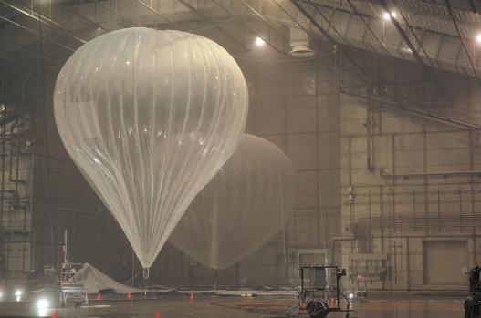
Why autonomous? Infrastructure!
Autonomous drones are required when you need to fly constantly or anytime.
Ex: drone as an infrastructure in the sky.
Photos: X (Google) Loon*, Facebook’s Aquila*
*Other names and brands may be claimed as the property of others
https://plus.google.com/+ProjectLoon/posts/SLfUxHfXEnP https://www.facebook.com/notes/mark-zuckerberg/the-technology-behind-aquila/10153916136506634/

Slide 5
What’s different?
If you try to replace 1 delivery truck with 20 drones, you may save time and reduce costs but it’s not the only difference.
Here is a typical logistics chain for an online shop:
Country logistics hub
City logistics hub
Delivery site 1
Delivery site 2
Delivery site 3
Delivery site 4

Slide 6
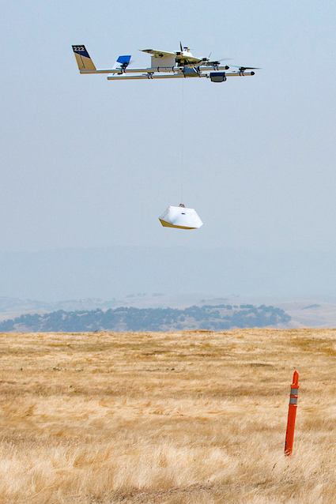
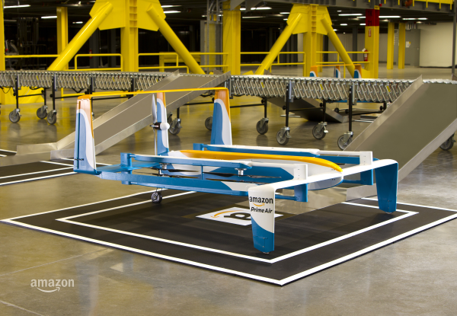
What’s different? Latency! Granularity!
Trucks:
are big: they load a maximum of packages to make it worthwhile.
depot is far: they have a minimum of deliveries each day.
to minimize distance, they specialize in 1 area of the city.
result: can achieve same day delivery with optimization, but can’t scale to 30mn-1hr deliveries.
Drones:
are variable in size: no minimal payload capacity
can work from smaller local logistics hubs
have a predictable flight time
result: can propose short latency delivery of small packages
If you can deliver 1 doughnut on demand, what else is possible? Photos: X (Google) Wing*, Amazon Prime Air*
*Other names and brands may be claimed as the property of others
https://x.company/projects/wing/ https://www.amazon.com/Amazon-Prime-Air

Slide 7
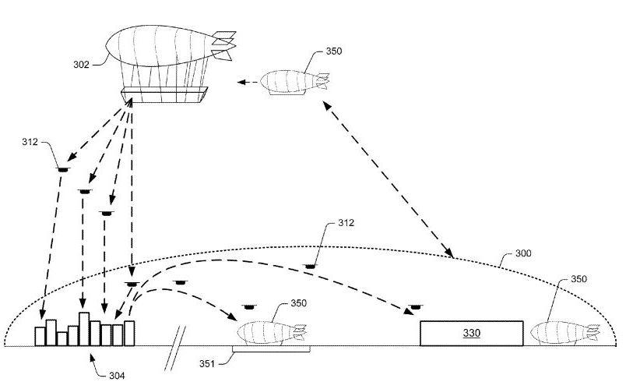

What’s different? Logistics centers!
Trucks: Currently large buildings, far from city centers.
Drones: Autonomous Drones come with automated logistics centers.
The large central centers could be replaced by several smaller automated logistics buffers.
Ex:
Flying warehouses?
Ships sailing in front of cities?
Direct delivery from trains, trucks?
Underground with an access shaft?
*
US Patent #: US009305280
*Other names and brands may be claimed as the property of others

Slide 8
Conclusion
Autonomous Drones are not only a way to make marketing stunts.
There’s a need and market today.
Drones are not just automating existing tasks.
They have specific requirements but enable new usages.

Slide 9
Thanks
Paul.Guermonprez@intel.com
https://intel-aero.github.io
Released under Creative Commons-BY creativecommons.org/licenses/by/2.0/

